Slide 1
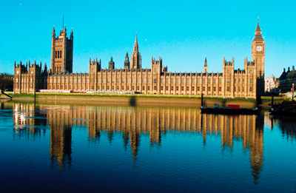
The political aspects of English Literature and Philosophy
Almost all the English writers and philosopher show their interest in politics in their works. We are going to analyse this relevant aspect of English cultural life in both literary and philosophical productions considering the period between the XVII and the XX century.
The background of the slides is Turner’s “Regolo”, a Romantic paintings that shows that also figurative art was interested in the English political life. Attilio Regolo sacrificed himself for Republican Rome’s sake.

Slide 2
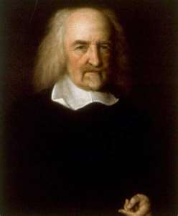
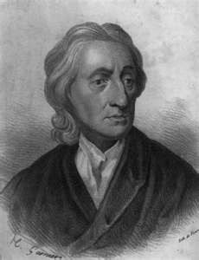
The philosophers of the XVII-XVIII centuries
Three are the main protagonists of English Philosophy in the XVII and the XVIII centuries: Thomas Hobbes (1588-1679), John Locke (1632-1704) and David Hume (1711-1776).
Thomas Hobbes
The natural desire leads to a constant war of all against all, but natural reason leads men to a pact, which leads to the formation of the absolute state. It is irreversible and unilateral, its power is indivisible, has judgment about good and evil and is not subject to the laws of the state itself.
John Locke
The state is a pact between citizens and derives from natural law. The power can not be absolute, since it must be controlled by the people who make the pact. Church and state are concerned with two areas: the second can invade the field of the first only if the church exceeds its limits, for example by resorting to force. All churches must be tolerated by the state.

Slide 3
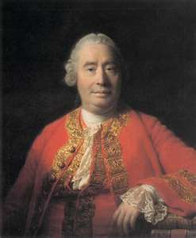
The philosophers of the XVII-XVIII centuries
Three are the main protagonists of English Philosophy in the XVII and the XVIII centuries: Thomas Hobbes (1588-1679), John Locke (1632-1704) and David Hume (1711-1776).
David Hume
What is useful is moral: what preserves the common good is good, what destroys it is bad. The policy is based on profit: its goal is to make people happy. Human duties in society are produced naturally by instinct or by the sense of obligation, which arises after the formation of the state.
Religion has always been connected to politics. So Hume analyses it. He thinks religion can not be justified theoretically, but it represents the natural history of man. At the beginning it is in the form of polytheism, then it turns to monotheism and believes in the omnipotence of God.

Slide 4
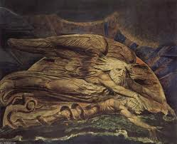
The poetry of the Romantic period
The French Revolution of the end of the XVIII century was deeply affected by the previous speculation of the Enlightenment. In its turn the Revolution influenced European Philosophy and literature. Pamphlets and satirical books were published to criticise the society of the “Ancien Régime” and celebrate the new revolutionary society. But after the Terror, which represented the failure of the ideals brought by the Enlightenment, and the rise of Napoleon, the European geography changed and, consequently, new literary and philosophical paths were reached.
Poetry was the new voice of protest against the wrong industrial society that was rising in that period. Poetry couldn’t develop during the XVIII century because the enlighten reason had dominated it. Now there was new room for feelings. The main representatives of this poetry with social and political aims were William Blake (1757-1827), William Wordsworth (1770-1850) and Lord Byron (1788-1824).

Slide 5
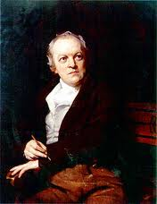
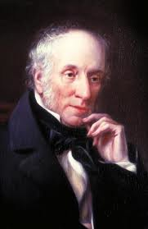
William Blake
In the dualistic vision of reality of the “Songs of Innocence and of Experience” he maintained the idea that every aspects of human life can be understood only if seen from two different points of view. The first is the one of the child (Innocence), the second the one of the adult (Experience). But the child is often deceived by society, like it happens in “The Chimney Sweeper”.
William Wordsworth
In the importance that this poet gave to nature we can see a reference to Rousseau’s philosophy and to the conviction that man is good by nature. So child is the condition in which man is privileged.

Slide 6
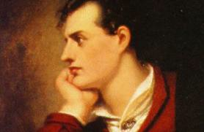
Lord George Gordon Byron
The Byronic hero is the typical literary figure of the “titan” that lives an interior thunderstorm and isn’t able to make himself understood by other people. His struggle against society shows the socio-political theme of Byron’s poetry.

Slide 7
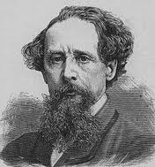
The novels of the Victorian Age
Even if the Victorian Age was a gold period for England, there were still a lot of social problems to solve. The novels of authors like Charles Dickens (1812-1870) and Robert Luois Stevenson (1850-1894) were characterised by the same social denounce of Blake’s poetry.
Charles Dickens
“Oliver Twist” well portrays the English society of the underworld and shows a deep critic to middle-class people’s hypocrisy. In fact Oliver is the metaphor for poor people who have to live and work without being paid in workhouses. Respectable and honest middle-class people considered poverty a crime and eliminated the problem by making people starving in horrible life conditions in the workhouses.
At the beginning of the extract from “Hard Times” that we have read the general characteristics of the town are described, with the monotonous rhythm of its machines and of its life. The law of the jungle rules in it, without possibility of escape. Man is crushed by the gears of a society that reminds in all his aspects the importance of factual life. And in the second part this concept is even more evident: the buildings of the town are all exactly like red brick warehouses.

Slide 8
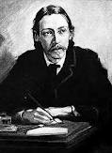
Robert Louis Stevenson
Stevenson criticizes middle-class respectability through his novel “Dr Jekyll and Mr Hyde”. Mr Hyde hides the dualism of middle-class people that usually behave showing good ideals in public, but have negative addictions in their private life: alcohol, drugs, etc.

Slide 9
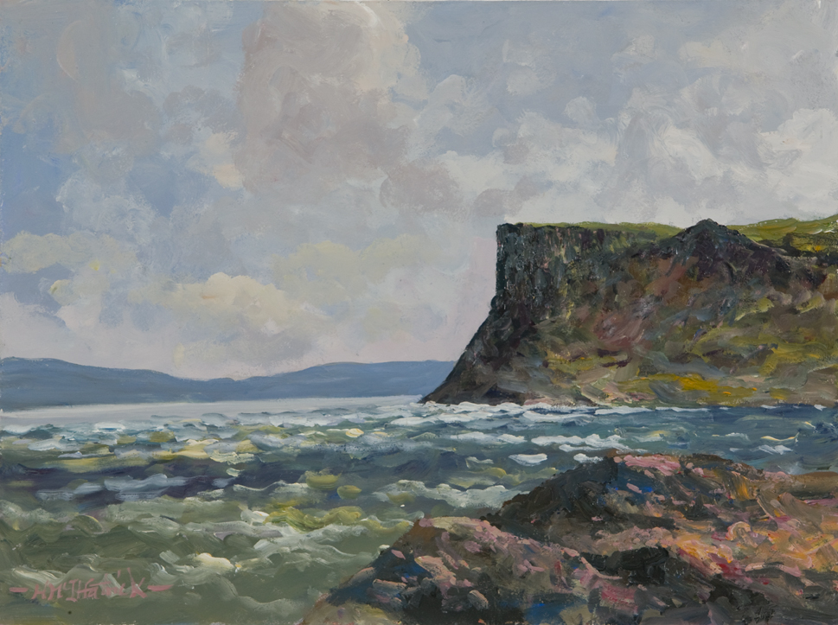
The “Irish Question” throughout the centuries
Jonathan Swift (1667-1745) had already criticised English bipartisanship in his satirical novel “Gulliver’s Travels” with the Lilliputians (divided in “High Heel” and “Low Heel”). Another Irish author that criticized Irish society was Oscar Wilde in many of his works. But it’s at the end of the nineteenth century that the Irish novelists and poets became very critical towards English society because of the English domination of Ireland. Some authors like Joyce were very critical towards their own country, too.

Slide 10
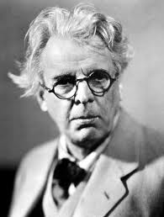
William Butler Yeats
During the First World War he develops his interest for contemporary Ireland. Perhaps he understands that, even if the legendary heroes lived in the past and can’t come back to life, now there are new heroes. They are the people who “dreamed and are dead”, just like he says in “Easter 1916”. The poem doesn’t describe the important insurrection happened in Dublin: it remains implicit.
Thought the poem is centred on Irish political life, the importance of Irish landscape is still present in it: in the third stanza the poet compares the rebels’ hearts to stones throw in the water. Even if nature changes and the clouds that “minute by minute change” move fast in the sky, the strong stone is “in the midst of all” and tries “To trouble the living stream”. The natural elements are used to represent the political actions of the rebels. They strengthen their relevance. In the last part of the poem Yeats wonders “when may it suffice”. He doesn’t know.

Slide 11
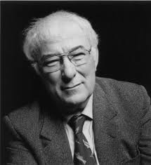
Seamus Heaney
He is Irish, but he criticises all the violence happened in his country. The Tollund man of homonymous poem is the metaphor of any violence in the name of religion. In fact the Tollund man has been sacrificed to get the fertility of nature. At the same way the violence inflicted to Catholics by Protestants and to Protestants by Catholics has a religious meaning that is linked to the political one. Heaney’s perplexity towards violence recalls, for some aspects, Yeats’ sentence “O when may it suffice?” referred to the sacrifice of the rebels.

Slide 12
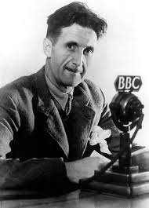
George Orwell’s fiction
Orwell’s fiction shows a constant analysis of society and of its unchangeable characteristics. This is evident in one of his masterpieces, “Animal Farm” (1945). In this novel he uses animals to represent the attempt of human society to rebel to the unjust government. But the attempt leads to a totalitarian government which is formed by some members of the rebels. The author’s choice to use animals as protagonists of the story is inspired by Swift’s “Gulliver’s travels”. The only well-organised society that Gulliver found in his travels was the one dominated by horses; the men were their slaves.
After the analysis of totalitarianism, Orwell centers his attention on the power of language and propaganda to create the “dystopia” of “Nineteen Eighty-Four”. The novel shows his worry for the power of mass media that he had already seen in all the totalitarian governments of the world.

